Slide 1
Islands online workshop
Held by CEIPES , 13/10/2023
Palermo, Date
Notes:
Welcome to the AHOD 360 online workshop of the intermediterranean area
In this meeting, we'll be introducing the All Hands On Deck 360 project, its partners, and the online portal for shipwrights that we are creating and [we hope] you are going to give life

Slide 2

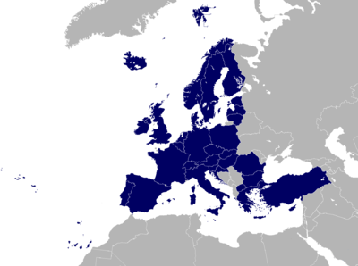

The project
Erasmus + KA220-VET - Cooperation partnerships in vocational education and training
5 partners, 4 countries, 6 maritime areas
Addressing digital transformation, contributing to innovation in shipwright, adapting it to labour market needs
Notes:
The All Hands On Deck 360 is an Erasmus + project with a collaboration between 5 partners of 4 countries: CETEM, InnovaWood, ILI-FAU, CEIPES, and the University of Murcia. In this project we are covering 6 maritime areas.
AHOD360 was born to cover some important needs in shipwright, one of the oldest professions in our continent, maybe the most important is to address the digital transformation, contributing to innovation in shipwright, adapting it to labour market needs, we are going to do with the use of immersive learning and new technologies (videos 360)

Slide 3


The partners
CETEM
Universidad de Murcia
CEIPES
Innovation in Learning Institute, Friedrich-Alexander-University Erlangen-Nuremberg
InnovaWood
Notes:
CETEM is a research and innovation center in Yecla, Spain, which specializes in wood and furniture-related industries.
The University of Murcia is a public research university in Spain. It is in involved through the scientific research research group “Chair of Naval History and Heritage”.
CEIPES is a European NGO based in Palermo, Italy, that works at local, European and international level in synergy with more than 100 organisations, bodies and institutions with the objective of improving methodologies and technologies in the field of education.
The Innovation in Learning Institute (ILI) is an institute for scientific research and the center for e-learning at the Friedrich-Alexander-University Erlangen-Nuremberg (FAU) as part of the Faculty of Philosophy.at the Friedrich-Alexander-Universität Erlangen-Nürnberg in Germany.
InnovaWood is an umbrella organisation that integrates different European networks in the Forest, Wood-based and Furniture industries into a more effective mechanism to support innovation in these sectors.

Slide 4
The objectives
Develop and implement innovative practices in VET learning of traditional sectors, in particular one of the oldest job positions in Europe: shipwright
Notes:
Develop and implement innovative practices in shipwright
Develop and implement innovative practices in VET learning of traditional sectors, in particular one of the oldest job positions in Europe: shipwright
Rejuvenating the shipwright workforce with 360 videos
Rejuvenating the shipwright workforce attracting young learners training them with practical clues which are usually learned in workshops, this will be done with immersive learning using new appealing technologies (as videos 360 with real shipwrights –WP4)
Increase the number of students in shipwright
Increase the number of students in VET woodworking and boat carpentry – even transferring professionals from related sectors
Enhance European connections within the craft
Enhance European connections and facilitate cooperation between professionals and learners of different maritime areas, with the objective to spread knowledge and increasing common projects and possibility for learners to move around Europe
Preserve the knowledge and know-how
Preserve practical knowledge and know-how of European shipwrights - record and digitalise interventions of current shipwrights of different maritime areas
Facilitate access to information
Facilitate access to information irrespective of the learner's location or financial resources

Slide 5
The objectives
Rejuvenating the shipwright workforce attracting young learners training them with practical clues which are usually learned in workshops, this will be done with immersive learning using new appealing technologies (as videos 360 with real shipwrights)
Notes:
Develop and implement innovative practices in shipwright
Develop and implement innovative practices in VET learning of traditional sectors, in particular one of the oldest job positions in Europe: shipwright
Rejuvenating the shipwright workforce with 360 videos
Rejuvenating the shipwright workforce attracting young learners training them with practical clues which are usually learned in workshops, this will be done with immersive learning using new appealing technologies (as videos 360 with real shipwrights –WP4)
Increase the number of students in shipwright
Increase the number of students in VET woodworking and boat carpentry – even transferring professionals from related sectors
Enhance European connections within the craft
Enhance European connections and facilitate cooperation between professionals and learners of different maritime areas, with the objective to spread knowledge and increasing common projects and possibility for learners to move around Europe
Preserve the knowledge and know-how
Preserve practical knowledge and know-how of European shipwrights - record and digitalise interventions of current shipwrights of different maritime areas
Facilitate access to information
Facilitate access to information irrespective of the learner's location or financial resources

Slide 6
The objectives
Increase the number of students in VET woodworking and boat carpentry – even transferring professionals from related sectors
Notes:
Develop and implement innovative practices in shipwright
Develop and implement innovative practices in VET learning of traditional sectors, in particular one of the oldest job positions in Europe: shipwright
Rejuvenating the shipwright workforce with 360 videos
Rejuvenating the shipwright workforce attracting young learners training them with practical clues which are usually learned in workshops, this will be done with immersive learning using new appealing technologies (as videos 360 with real shipwrights –WP4)
Increase the number of students in shipwright
Increase the number of students in VET woodworking and boat carpentry – even transferring professionals from related sectors
Enhance European connections within the craft
Enhance European connections and facilitate cooperation between professionals and learners of different maritime areas, with the objective to spread knowledge and increasing common projects and possibility for learners to move around Europe
Preserve the knowledge and know-how
Preserve practical knowledge and know-how of European shipwrights - record and digitalise interventions of current shipwrights of different maritime areas
Facilitate access to information
Facilitate access to information irrespective of the learner's location or financial resources

Slide 7
The objectives
Enhance European connections and facilitate cooperation between professionals and learners of different maritime areas, with the objective to spread knowledge and increasing common projects and possibility for learners to move around Europe
Notes:
Develop and implement innovative practices in shipwright
Develop and implement innovative practices in VET learning of traditional sectors, in particular one of the oldest job positions in Europe: shipwright
Rejuvenating the shipwright workforce with 360 videos
Rejuvenating the shipwright workforce attracting young learners training them with practical clues which are usually learned in workshops, this will be done with immersive learning using new appealing technologies (as videos 360 with real shipwrights –WP4)
Increase the number of students in shipwright
Increase the number of students in VET woodworking and boat carpentry – even transferring professionals from related sectors
Enhance European connections within the craft
Enhance European connections and facilitate cooperation between professionals and learners of different maritime areas, with the objective to spread knowledge and increasing common projects and possibility for learners to move around Europe
Preserve the knowledge and know-how
Preserve practical knowledge and know-how of European shipwrights - record and digitalise interventions of current shipwrights of different maritime areas
Facilitate access to information
Facilitate access to information irrespective of the learner's location or financial resources

Slide 8
The objectives
Preserve practical knowledge and know-how of European shipwrights - record and digitalise interventions of current shipwrights of different maritime areas
Notes:
Develop and implement innovative practices in shipwright
Develop and implement innovative practices in VET learning of traditional sectors, in particular one of the oldest job positions in Europe: shipwright
Rejuvenating the shipwright workforce with 360 videos
Rejuvenating the shipwright workforce attracting young learners training them with practical clues which are usually learned in workshops, this will be done with immersive learning using new appealing technologies (as videos 360 with real shipwrights –WP4)
Increase the number of students in shipwright
Increase the number of students in VET woodworking and boat carpentry – even transferring professionals from related sectors
Enhance European connections within the craft
Enhance European connections and facilitate cooperation between professionals and learners of different maritime areas, with the objective to spread knowledge and increasing common projects and possibility for learners to move around Europe
Preserve the knowledge and know-how
Preserve practical knowledge and know-how of European shipwrights - record and digitalise interventions of current shipwrights of different maritime areas
Facilitate access to information
Facilitate access to information irrespective of the learner's location or financial resources

Slide 9
The objectives
Facilitate access to information irrespective of the learner's location or financial resources
Notes:
Develop and implement innovative practices in shipwright
Develop and implement innovative practices in VET learning of traditional sectors, in particular one of the oldest job positions in Europe: shipwright
Rejuvenating the shipwright workforce with 360 videos
Rejuvenating the shipwright workforce attracting young learners training them with practical clues which are usually learned in workshops, this will be done with immersive learning using new appealing technologies (as videos 360 with real shipwrights –WP4)
Increase the number of students in shipwright
Increase the number of students in VET woodworking and boat carpentry – even transferring professionals from related sectors
Enhance European connections within the craft
Enhance European connections and facilitate cooperation between professionals and learners of different maritime areas, with the objective to spread knowledge and increasing common projects and possibility for learners to move around Europe
Preserve the knowledge and know-how
Preserve practical knowledge and know-how of European shipwrights - record and digitalise interventions of current shipwrights of different maritime areas
Facilitate access to information
Facilitate access to information irrespective of the learner's location or financial resources

Slide 10
Collaborative portal
Creation and release a portal 2.0 as a collaborative tool where learners and shipwright professionals could have contact and could share their different ideas, projects, doubts with other learners and professionals around Europe.
3 MAIN NODES:
Shipwright-learners
Shipwright-shipyards
Shipwright-shipwright
Notes:
I am going to present one of the results of the project which is active, we have other 2 results which are currently in development, but I will mention them in the last part of the workshop
This is the collaborative portal
Objective is the Creation and release a portal 2.0 as a collaborative tool where learners and shipwright professionals could have contact and could share their different ideas, projects, doubts with other learners and professionals around Europe.
This collaborative portal has 3 MAIN NODES:
• Relation Shipwright-learners
• Relation Shipwright-shipyards
• Relation Shipwright with other shipwrights

Slide 11
Collaborative portal
In each node:
A general forum
Specific forums of important topics
A question and answers area
A sharing collaborative space
A notice board with learning or professional opportunities
Possibility of sending and receiving messages
Notes:
In each node the objective was to have:
A general forum
Specific forums of important topics
A question and answers area
A sharing collaborative space
A notice board with learning or professional opportunities
Possibility of sending and receiving messages

Slide 12
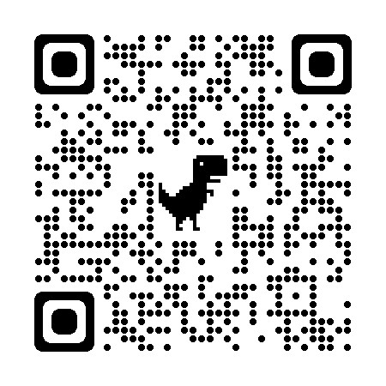
Collaborative portal
The link to the portal is
https://ahod360.infoproject.eu/community

Slide 13
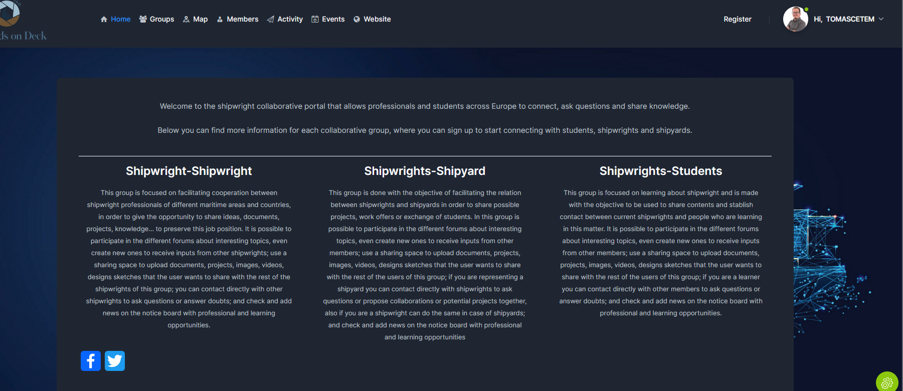
Collaborative portal
The link to the portal is
https://ahod360.infoproject.eu/community

Slide 14
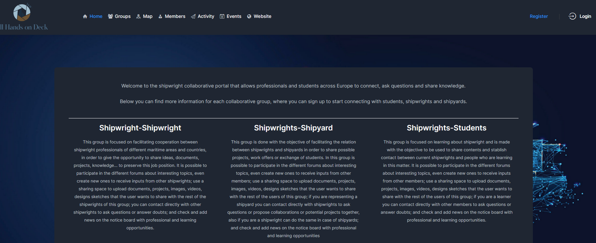

Collaborative portal
To register on the portal is
https://ahod360.infoproject.eu/community/register/
Notes:
First of all you have to register on the portal, you have 3 ways of doing it, one is writing the link which is on the slide, second option is clicking on the top right side of the homepage, where it is said “register” or using the QR of the screen, which is different than the previous one.

Slide 15
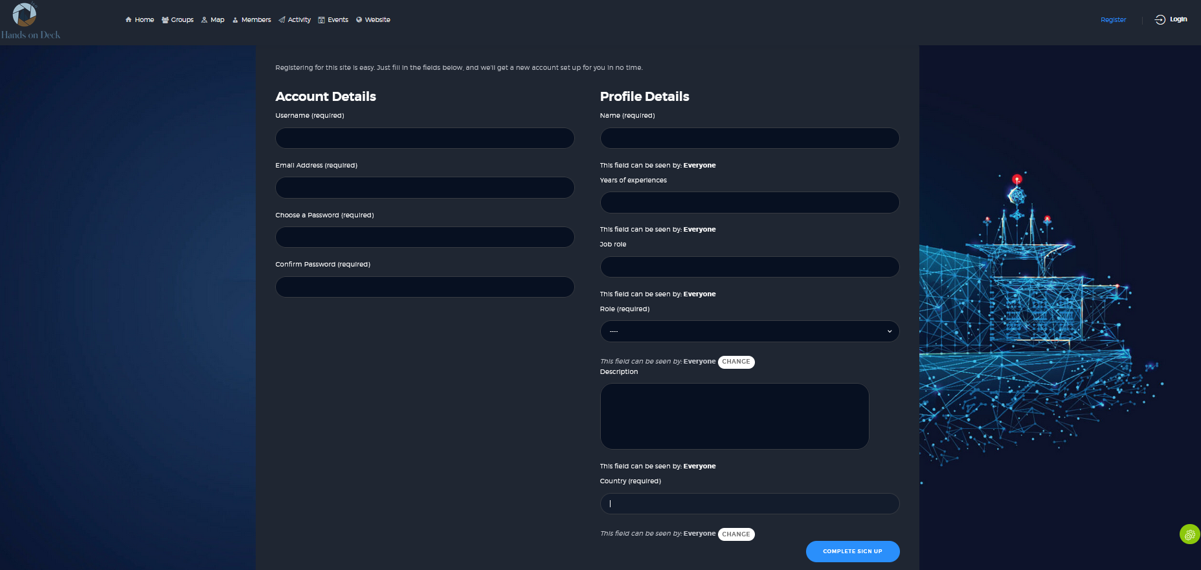
Collaborative portal
Notes:
There are needed only 4-5 data to be registered, username (remind your username to Access later to the collaborative portal, your email, your password. It is needed that you add your name, years of experience in this field, your job role and select the role that you want to have on the Project: shipwright, shipyard or student. Please try to be registered filling the data.

Slide 16
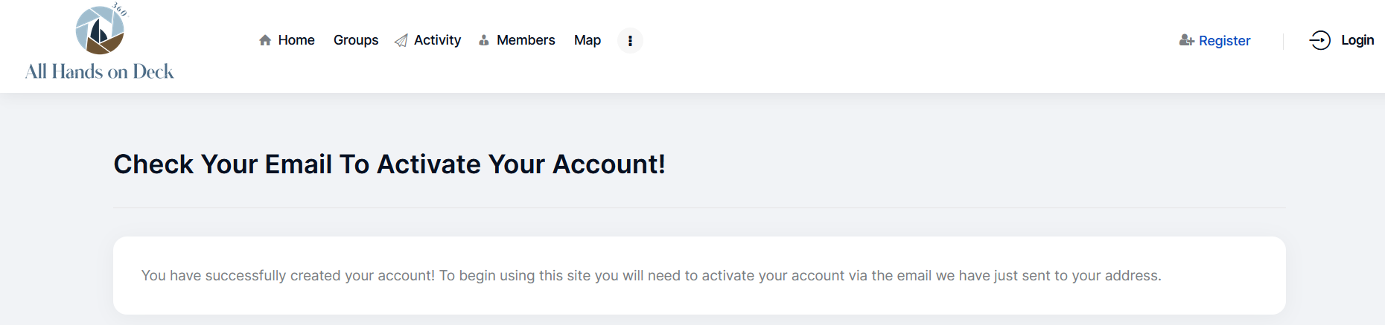
Collaborative portal
Notes:
After this, You have to actívate your account with an email that you should have received in the email that you have given

Slide 17
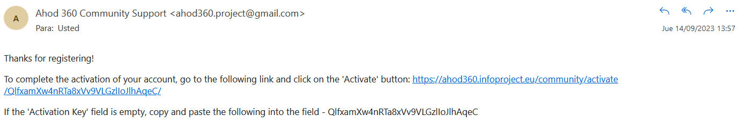
Collaborative portal
Notes:
You Will receive this email, only you need to press the link

Slide 18
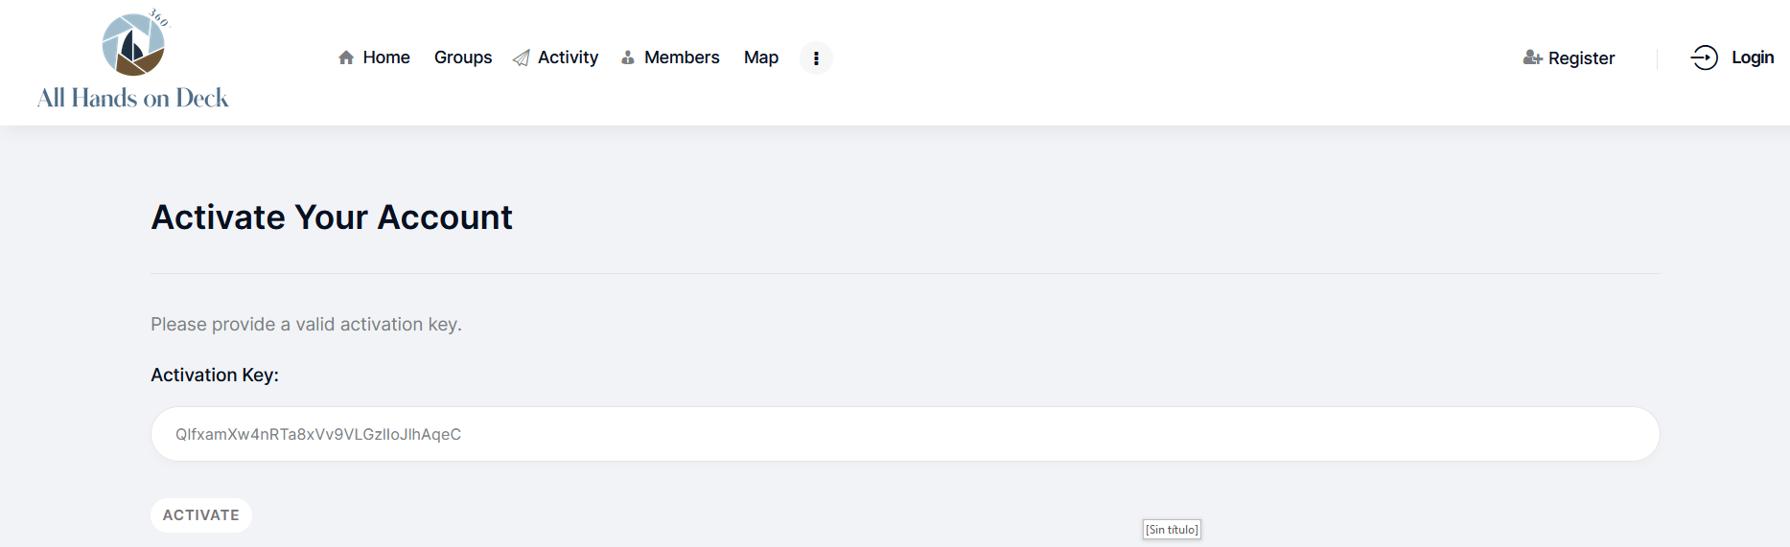
Collaborative portal
Notes:
It is opened the collaborative portal and you have to press only “actívate”. This is done to achieve that bots could not be registered and share publicity

Slide 19
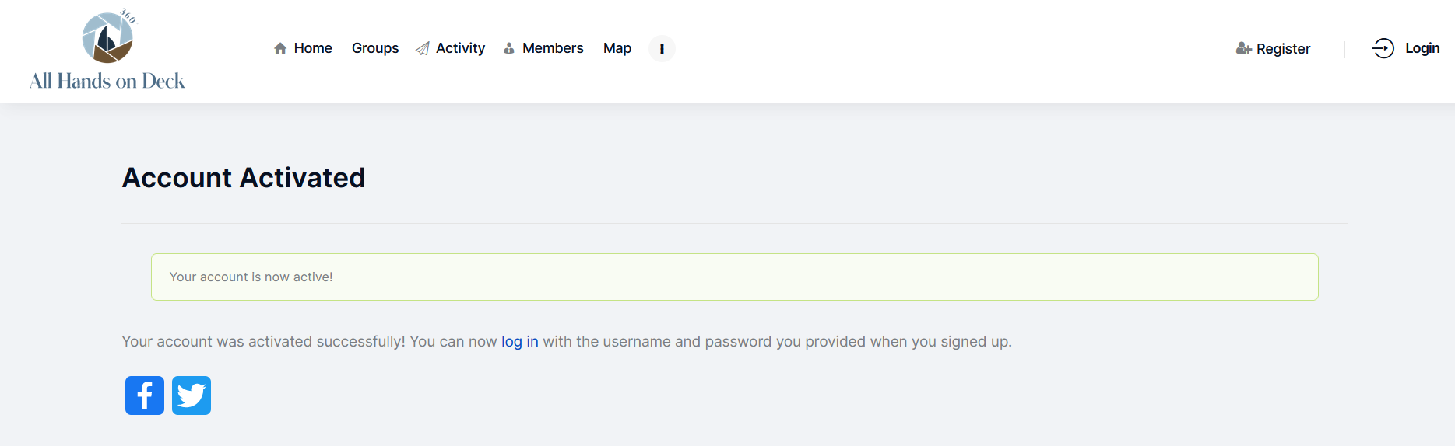
Collaborative portal
Notes:
If you have done it correctly, this Will appear and you can login

Slide 20
Collaborative portal
Notes:
You could go inside the collaborative portal and login, login is on the top right of the screen

Slide 21
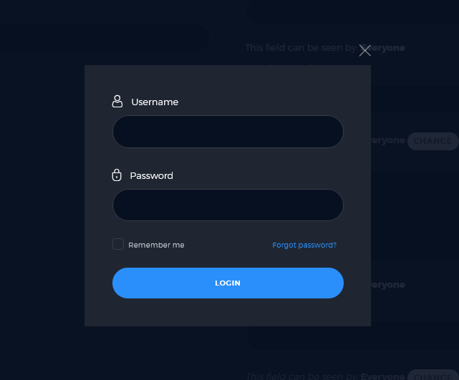
Collaborative portal
Notes:
For login, You only need the username and the password

Slide 22
Collaborative portal
Notes:
Make sure you have logged in correctly, by checking that your user name appears at the top right-hand side of the screen.

Slide 23
Collaborative portal
Notes:
This is the front page of the collaborative portal, which is called "Home" and simply explains the 3 main groups I have mentioned:
- Shipwright – Student
- Shipwright – Shipyard
- Shipwright – Shipwright

Slide 24
Collaborative portal
Notes:
Most important section is “Groups”

Slide 25
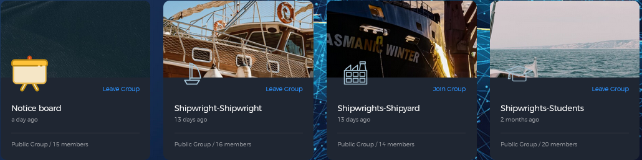
Collaborative portal
4 nodes/groups
Notes:
You go inside the portal and you can navigate inside, my recommendation is to join the groups that are inside because inside there are the most important information. You can join every every group if you want.

Slide 26
Collaborative portal
4 nodes/groups
Notes:
You can go inside the different groups after join it, you can leave the Group if you want

Slide 27
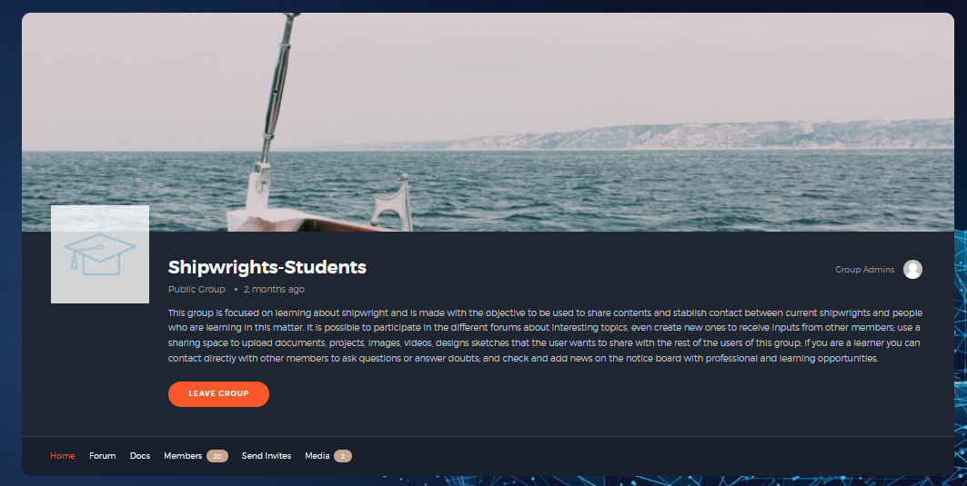
Collaborative portal
Notes:
One of the groups are shipwright-students “This group is focused on learning about shipwright and is made with the objective to be used to share contents and stablish contact between current shipwrights and people who are learning in this matter. It is possible to participate in the different forums about interesting topics, even create new ones to receive inputs from other members; use a sharing space to upload documents, projects, images, videos, designs sketches that the user wants to share with the rest of the users of this group; if you are a learner you can contact directly with other members to ask questions or answer doubts; and check and add news on the notice board with professional and learning opportunities.
As you can check, you have the possibility to enter in Home (by defect) different forums, Docs, Members, send invites and Media

Slide 28
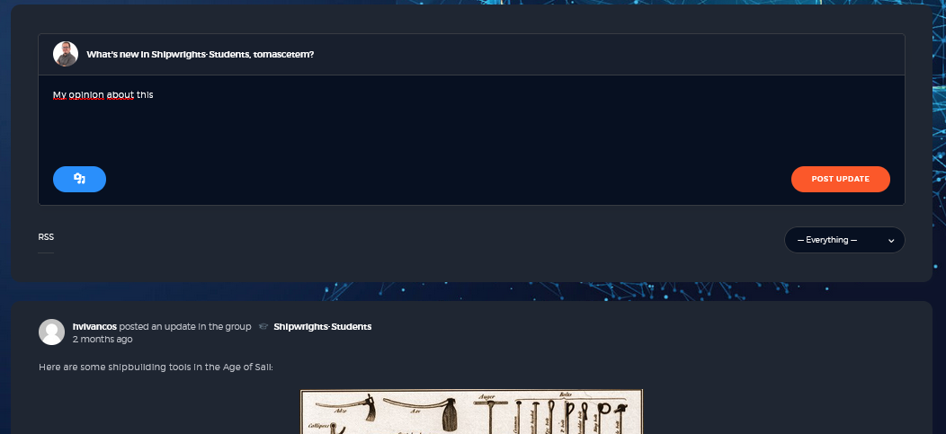
Collaborative portal
Notes:
In home of the Group you have Access to the general fórum, here you can ask any question to all the community or share your opinion.
It is really easy, you have to write directly after the questions “what´s new in shipwright-student?, you can attach images and after that, press post update

Slide 29
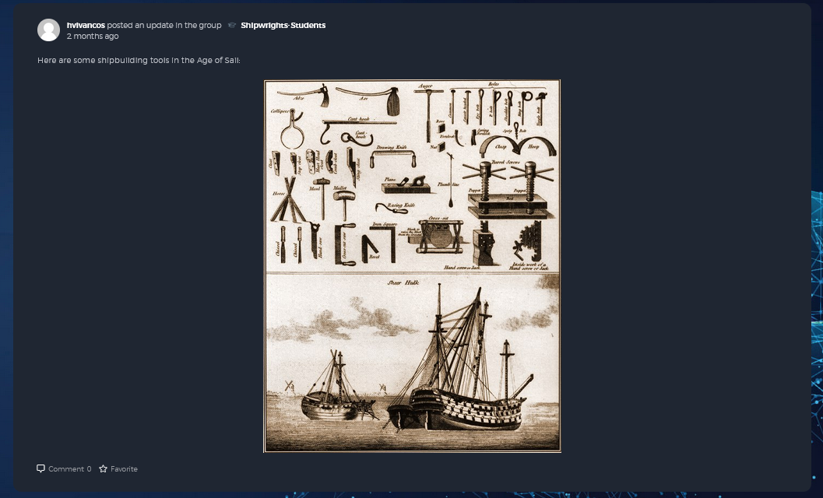
Collaborative portal
Notes:
You can read contributions of other members and give your opinion, or answer their questions

Slide 30
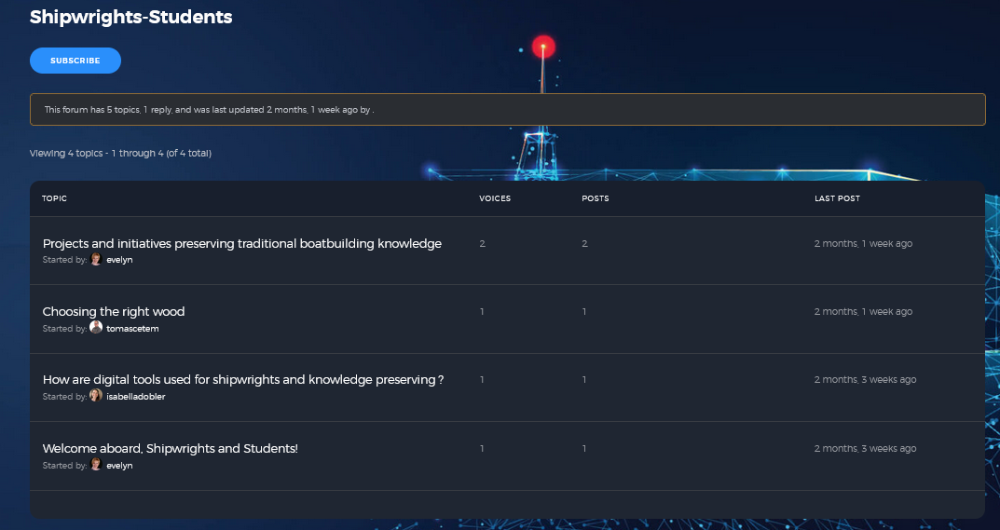
Collaborative portal
Notes:
You can Access to the topics on the fórum that other members have created but also you can create your own topic

Slide 31
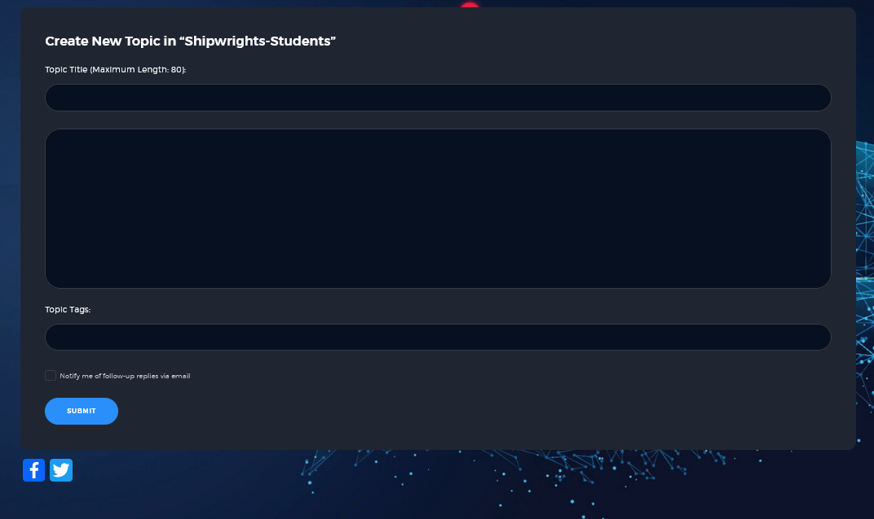
Collaborative portal
Notes:
You have to give to your topic a title and tags,

Slide 32
Collaborative portal
Notes:
You can share documents and media with the other members

Slide 33
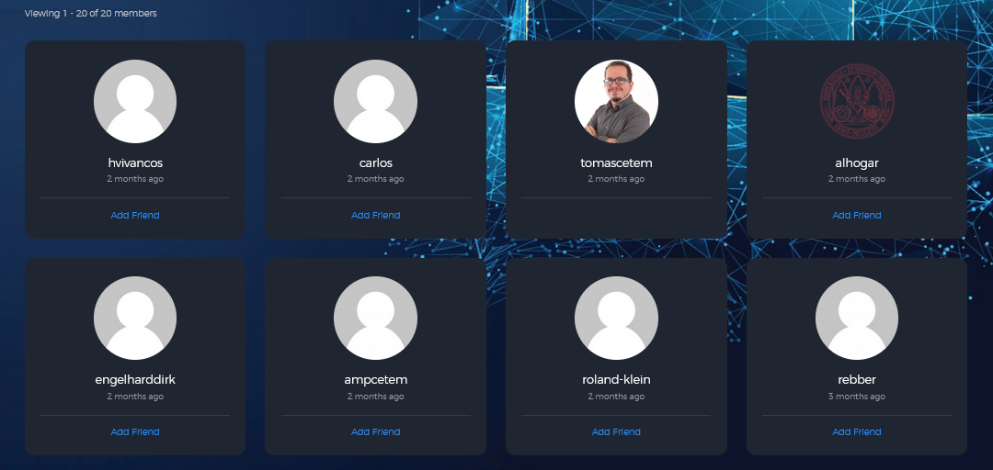
Collaborative portal
Notes:
In members you could check the people who are registered in that Group, you can send a friend invitation to them

Slide 34
Collaborative portal
4 nodes/groups
Notes:
Rest nodes/groups are following the same philosophy

Slide 35
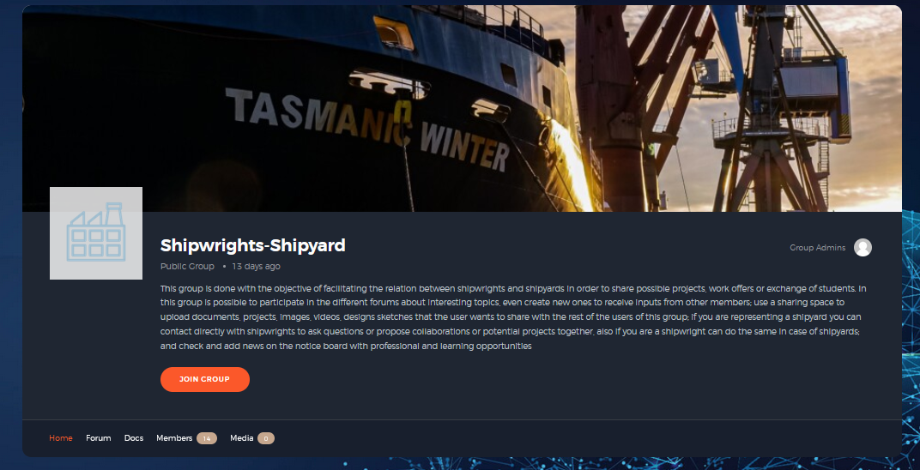
Collaborative portal
Notes:
This Group is shipwright-shipyard “This group is done with the objective of facilitating the relation between shipwrights and shipyards in order to share possible projects, work offers or exchange of students. In this group is possible to participate in the different forums about interesting topics, even create new ones to receive inputs from other members; use a sharing space to upload documents, projects, images, videos, designs sketches that the user wants to share with the rest of the users of this group; if you are representing a shipyard you can contact directly with shipwrights to ask questions or propose collaborations or potential projects together, also if you are a shipwright can do the same in case of shipyards; and check and add news on the notice board with professional and learning opportunities.
This group has the same structure than the previous one

Slide 36
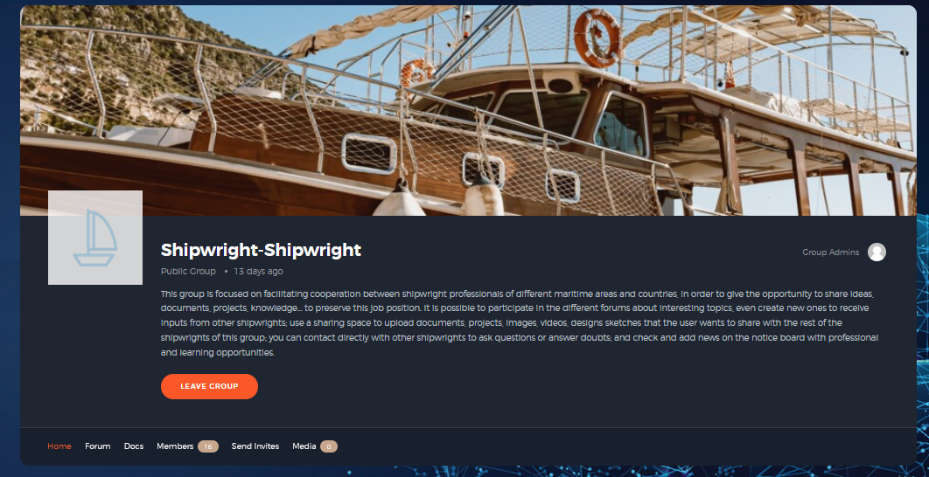
Collaborative portal
Notes:
And finally shipwright-shipwright “This group is focused on facilitating cooperation between shipwright professionals of different maritime areas and countries, in order to give the opportunity to share ideas, documents, projects, knowledge… to preserve this job position. It is possible to participate in the different forums about interesting topics, even create new ones to receive inputs from other shipwrights; use a sharing space to upload documents, projects, images, videos, designs sketches that the user wants to share with the rest of the shipwrights of this group; you can contact directly with other shipwrights to ask questions or answer doubts; and check and add news on the notice board with professional and learning opportunities..
This group has the same structure than the previous ones

Slide 37
Collaborative portal
4 nodes
Notes:
Last one is “Notice Board” to share new opportunities, job offers

Slide 38
Collaborative portal
Notes:
Finally, we are going to focus on the top of the collaborative portal, mostly with 3 important sections: Activity, Members and Map.
In activity, you can check all the changes inside the collaborative portal

Slide 39
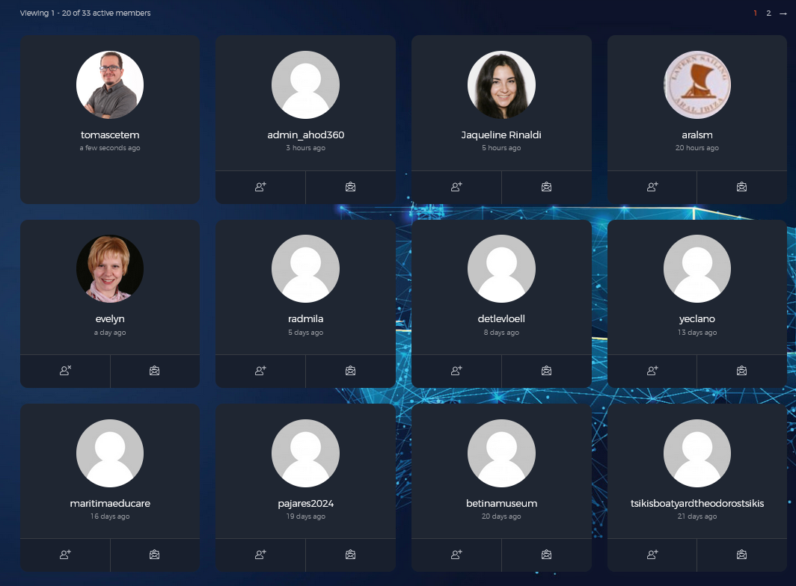
Collaborative portal
Notes:
In members, you have Access to the username of all the members of the collaborative portal, and you can send an invitation to be Friends, and more important you can send a private message if you want to ask some doubt or share something

Slide 40
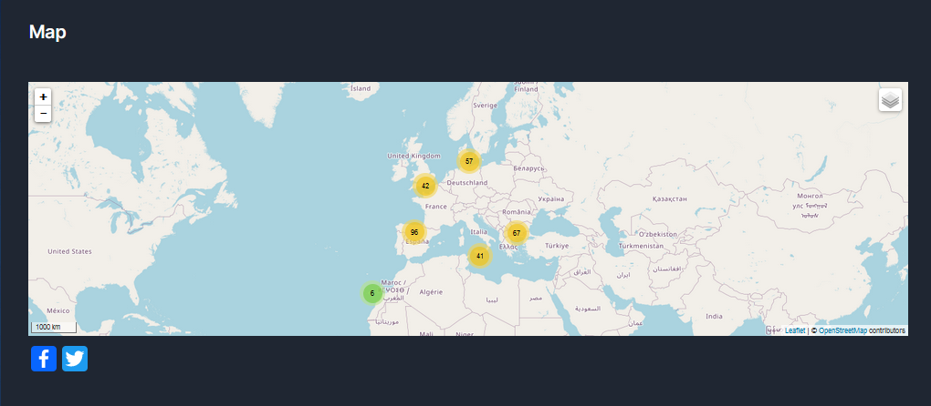
Collaborative portal
Notes:
And map, which is a digital map with different stakeholders in the boatbuilding sector. There are different organisations who play an important role in boatbuilding in wood. They are shown with name, a brief description of activities and website.

Slide 41
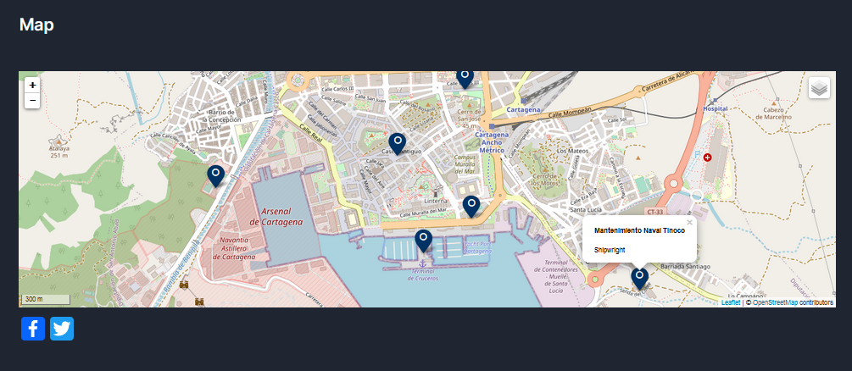
Collaborative portal
Notes:
In the map, you can get closer to the different points which is a stakeholder and check where they are allocated

Slide 42
Other future results
Multilingual Terminology Database Platform
Free access online platform with a complete database with current and historical used terms in shipwright in the different maritime areas in Europe which could be used by professionals of different countries, VET teachers, learners, professionals of other related job positions, researchers or amateurs.
It will be composed of a dictionary of more than 1000 terms divided in thematic areas or subjects and maritime areas, translated into 5 languages (English, Spanish, German, Italian and French) including voice notes showing the correct pronunciation of the terms and images of each one of them.

Slide 43
Other future results
Multilingual Terminology Database Platform
Users will be able to search for the word or looking in thematic areas or maritime areas because the platform will list the word entries alphabetically and it will be included in thematic and maritime areas. A learner will be able to select a desired language first and search a word directly or in an area and it will appear the translation to the other 4 languages, the description in the chosen language, a suitable image, a voice note, synonyms and thematic and maritime area where is used.
WE NEED PROFESSIONALS TO GIVE COMMENTS ABOUT THE 1000 TERMS

Slide 44
Other future results
360º Virtual Tours of shipyards from different maritime areas
360° panoramic tour conceptual design document explaining the selection process of the shipyards at five maritime locations.
360° panoramic tour content concept document for all yards with naming of identified information units and information bundles on relevant tools, machines, materials and working methods for the hotspots within the tour.
One informative accompanying document containing a clear description of the content element types as well as the concrete contents of the information texts and illustrations. It is downloadable and printable.
Notes:
360° panoramic tour conceptual design document explaining the selection process of the shipyards at five
maritime locations.
360° panoramic tour content concept document for all yards with naming of identified information units and
information bundles on relevant tools, machines, materials and working methods for the hotspots within the tour.
One informative accompanying document containing a clear description of the content element types as well as the concrete contents of the information texts and illustrations. It is downloadable and printable.

Slide 45
Other future results
360º Virtual Tours of shipyards from different maritime areas
Development of a total of 5 360° panoramic tours of real shipyards from 5 different maritime locations. The virtual interior and exterior of the shipyards contain numerous hotspots as access to the learning materials. The main component consists of immersive videos in which boat builders convey their knowledge and know-how orally, as well as numerous other learning elements of different element types (photos, audios, links).
Development of interactive test questions of different question types with detailed feedback for learners to self-assess the level of knowledge acquired following the virtual tour of each shipyard.
WE NEED PROFESSIONALS TO VISIT TO RECORD HOW THEY ARE WORKING AND EXPLAIN THEIR JOB
Notes:
Development of a total of 5 360° panoramic tours of real shipyards from 5 different maritime locations. The virtual interior and exterior of the shipyards contain numerous hotspots as access to the learning materials. The main component consists of immersive videos in which boat builders convey their knowledge and know-how orally, as well as numerous other learning elements of different element types (photos, audios, links).
Development of interactive test questions of different question types with detailed feedback for learners to self-assess the level of knowledge acquired following the virtual tour of each shipyard.
WE NEED PROFESSIONALS TO VISIT TO RECORD HOW THEY ARE WORKING AND EXPLAIN THEIR JOB

Slide 46
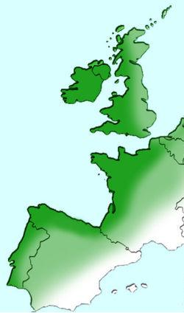






Maritime areas (in the project)
ATLANTIC ARC
North
North
South

Slide 47
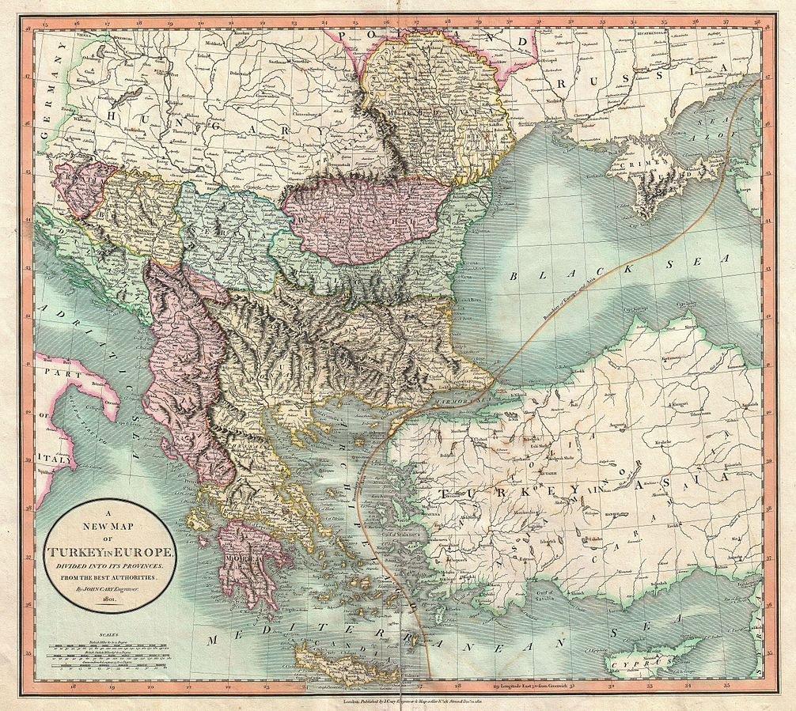









Maritime areas (in the project)
BALKAN & BLACK SEA
North
Continental

Slide 48
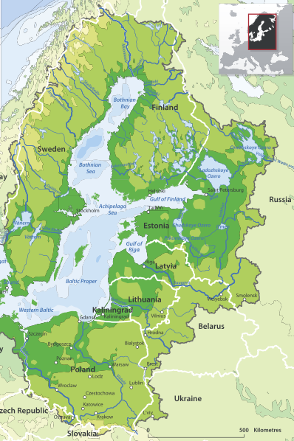







Maritime areas (in the project)
BALTIC SEA
Mecklenburg
Schleswig-Holstein

Slide 49
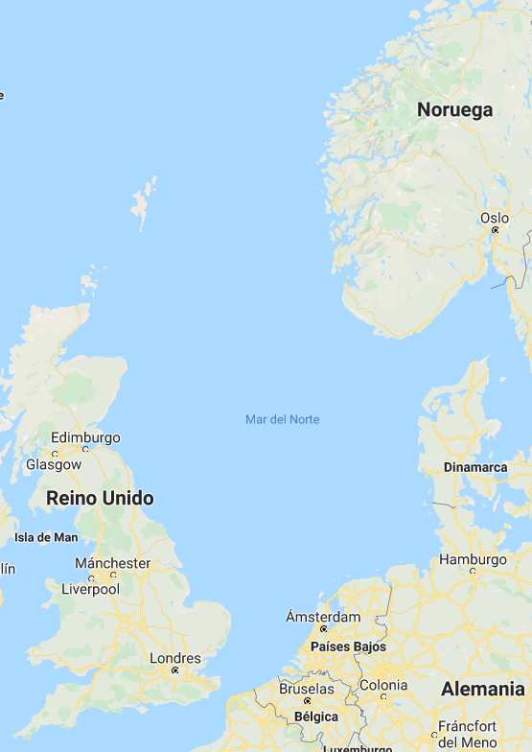





Maritime areas (in the project)
NORTH SEA
East

Slide 50
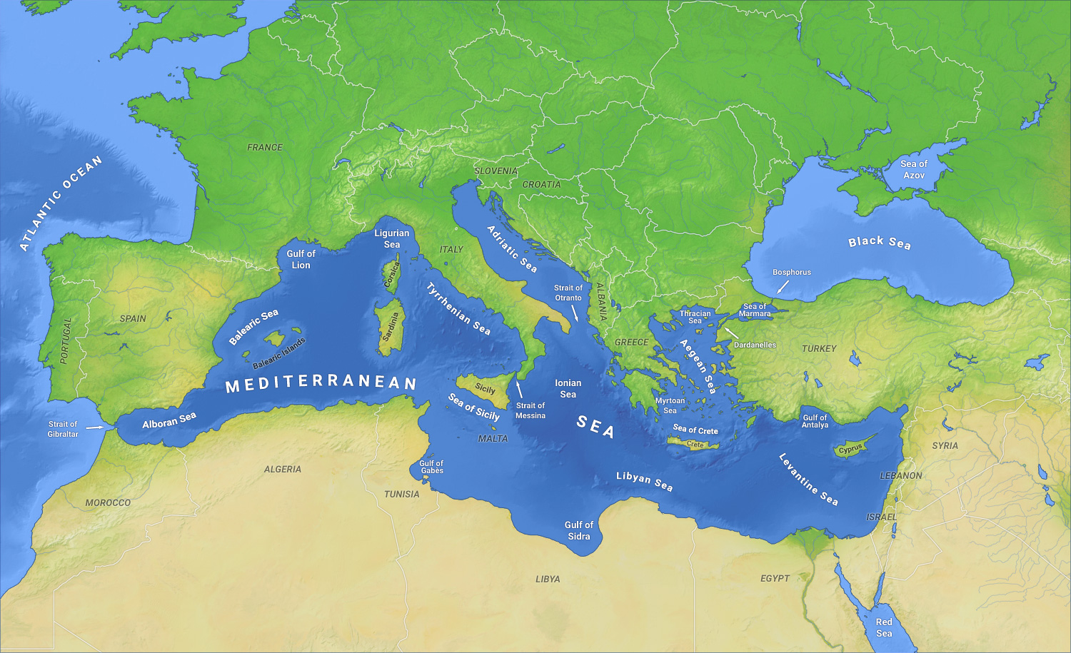

Maritime areas (in the project)
INTERMEDITERRANEAN
South
South
South

Slide 51
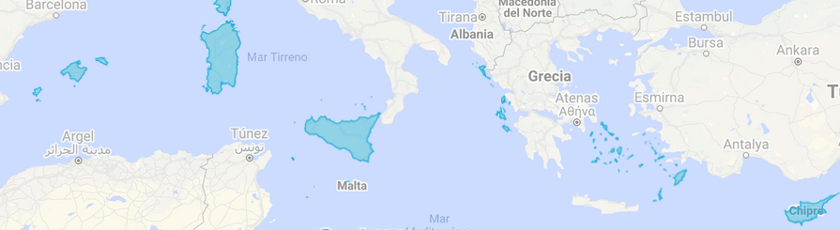
Maritime areas (in the project)
ISLANDS
- Canarian Islands
- Balearic Islands
- Corsica
- Sardinia
- Sicily
- Greek Islands including Crete
- Cyprus
- Malta

Slide 52
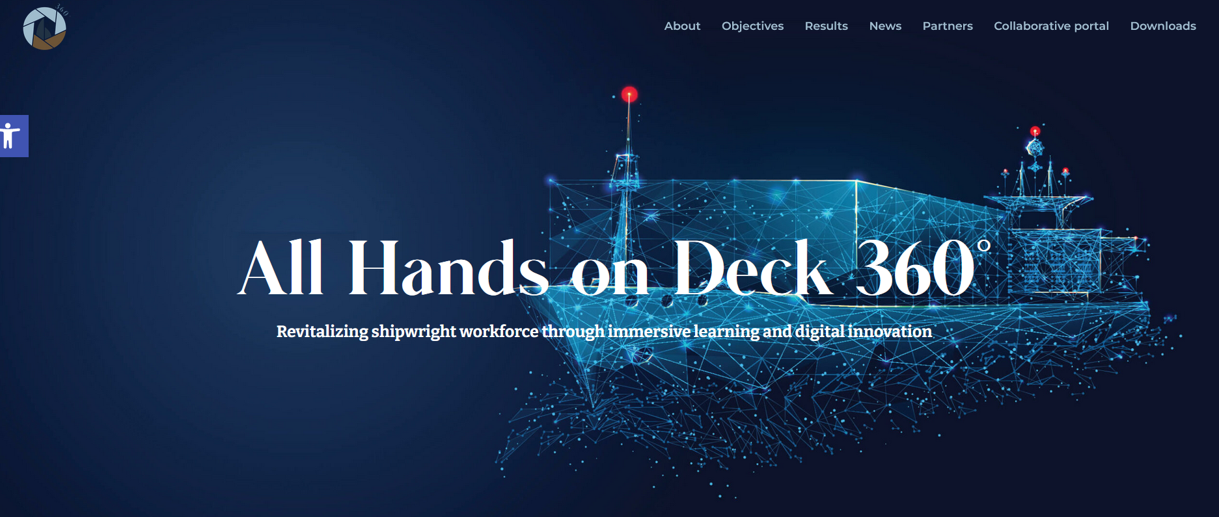
You can visit our website: https://ahod360.infoproject.eu/
Notes:
You can access to our website and know more about project, partners and results

Slide 53

Jaqueline Rinaldi
TUTOR
jaqueline.rinaldi@ceipes.org
Notes:
You can write me to collaborate or ask something about the project

